Slide 1

Blood Availability Management System
DAMG-6210 Project Team - 2
Done by:
Srihitha Kilari - 002138766
Vaishnavi sai Challagulla - 002959612
Mannem Kavya - 002194057

Slide 2
Mission Statement
The purpose of this project is to develop a blood donation system for the city of Boston. It will be used by all the hospitals, blood banks and people who register for blood donation to facilitate functionalities like blood donating, checking blood availability, and analysis of blood requirements in hospitals.

Slide 3
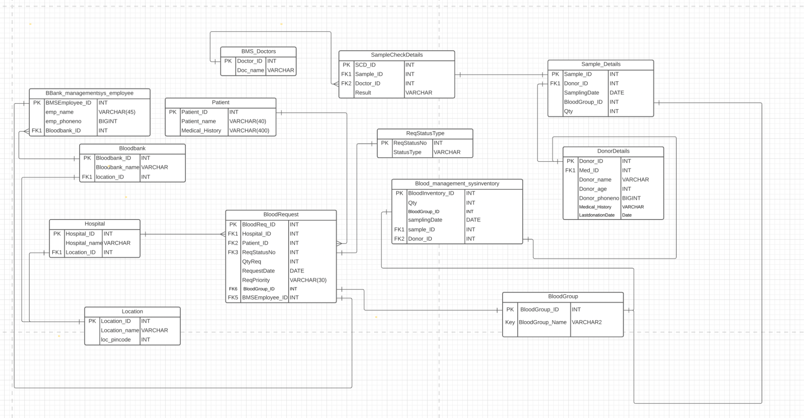
ERD

Slide 4
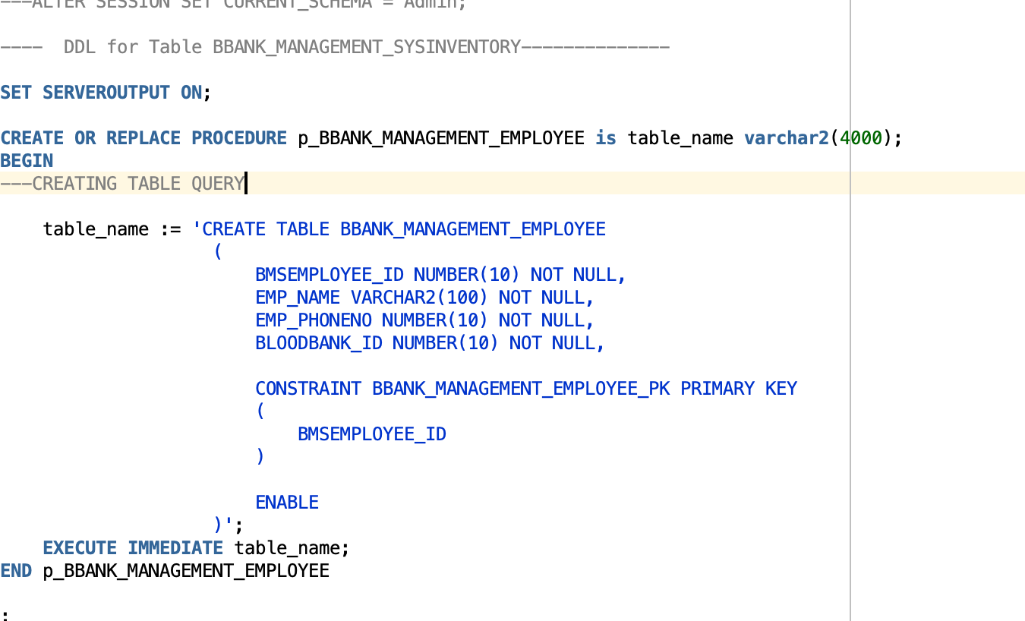
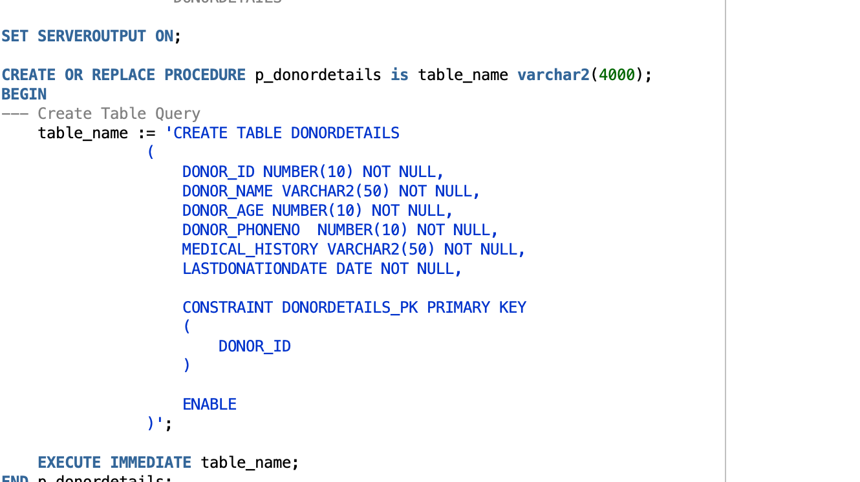
Creating Procedures
400

Slide 5
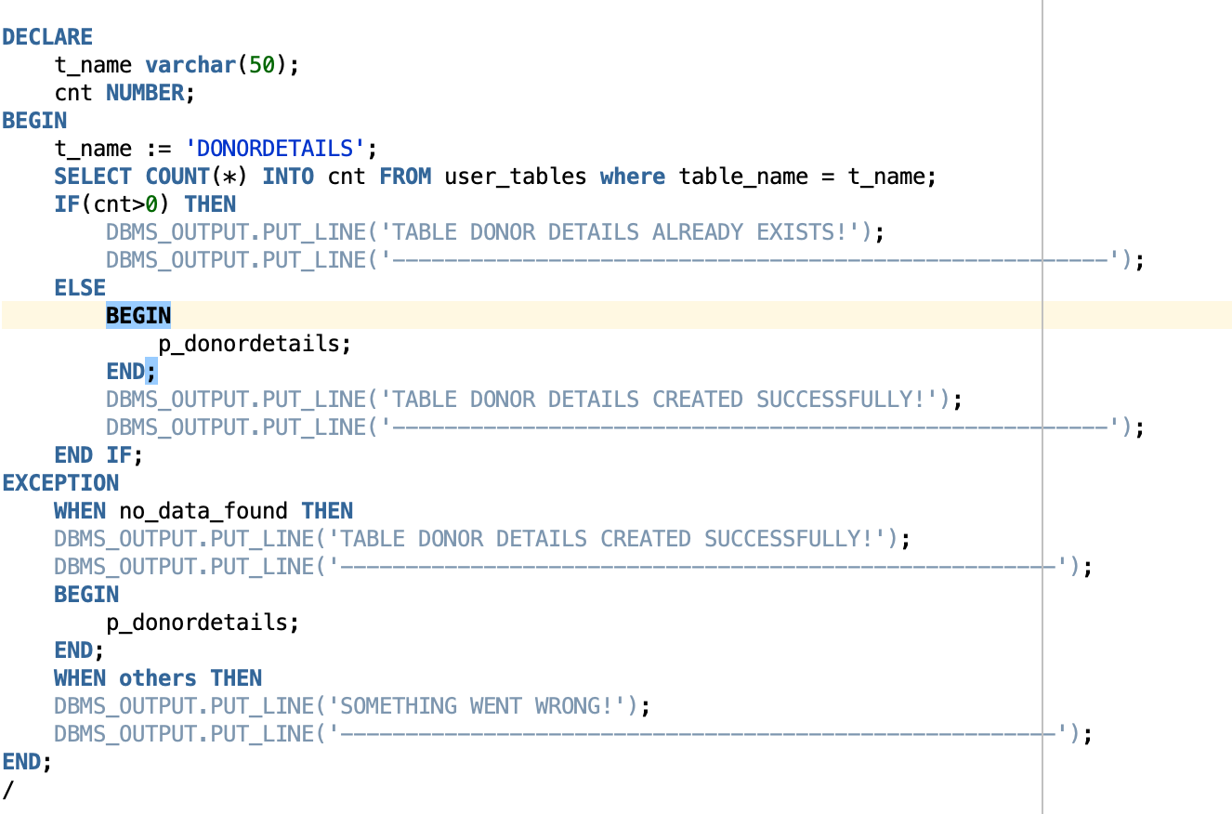
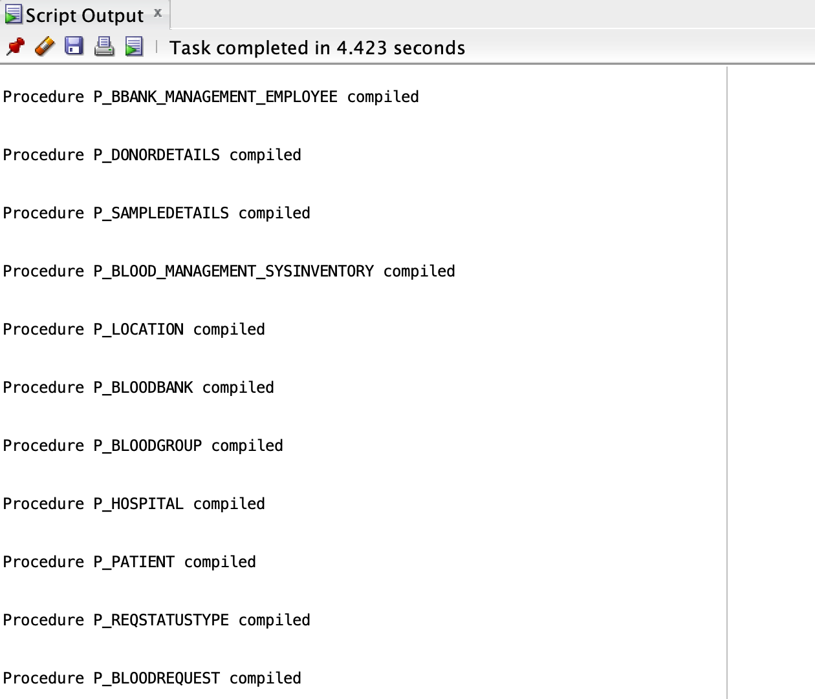
Creating Procedures

Slide 6
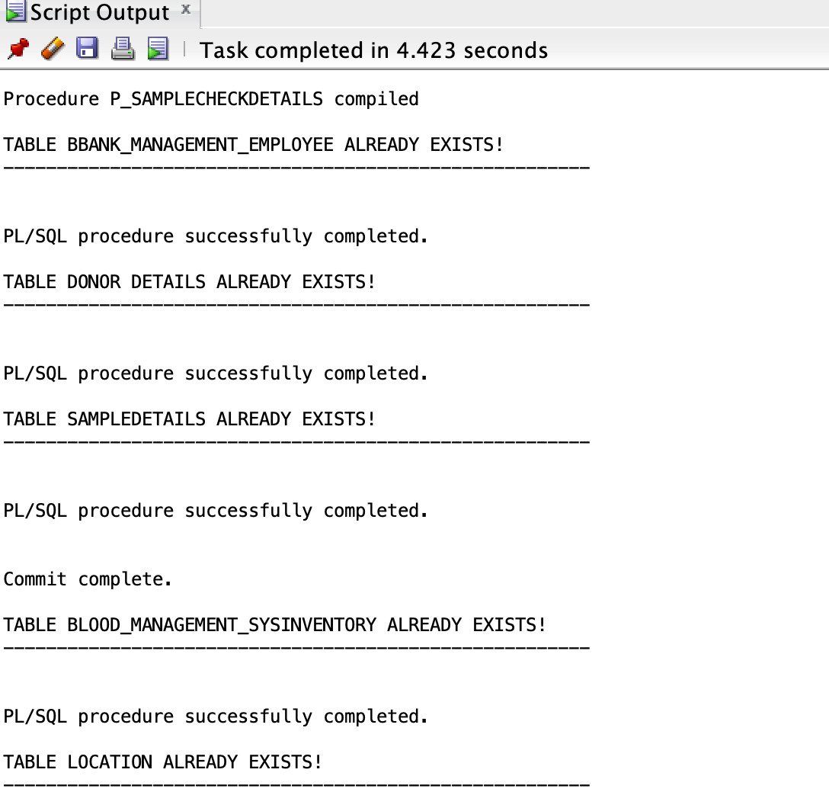
Creating Procedures

Slide 7
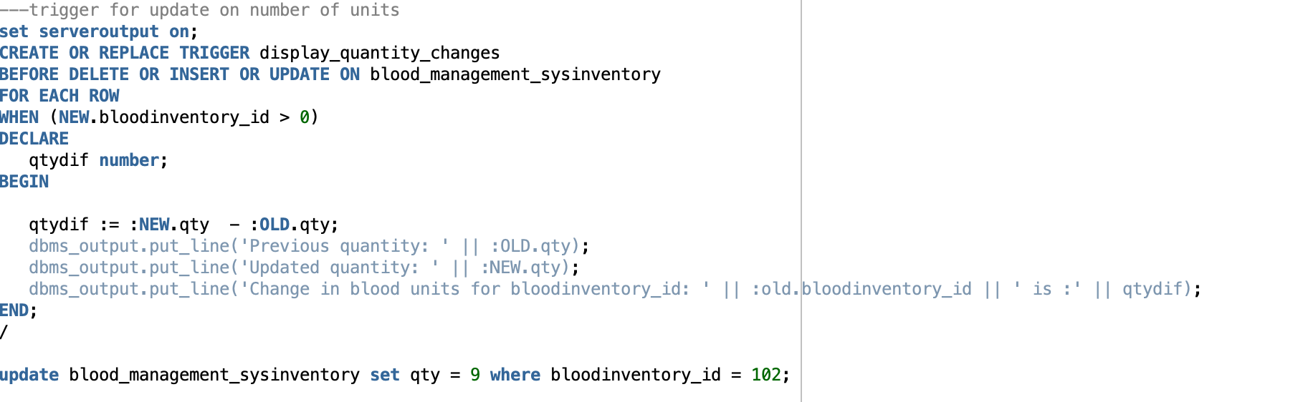
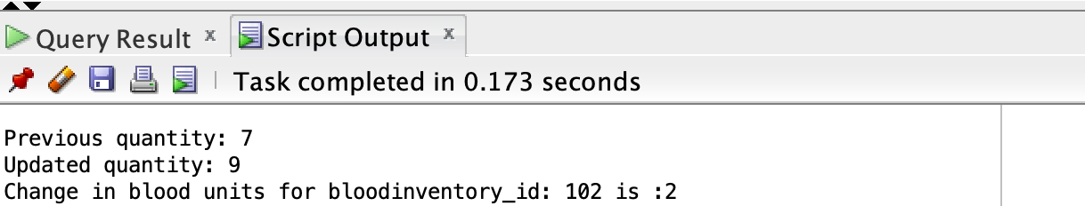
TRIGGERS

Slide 8
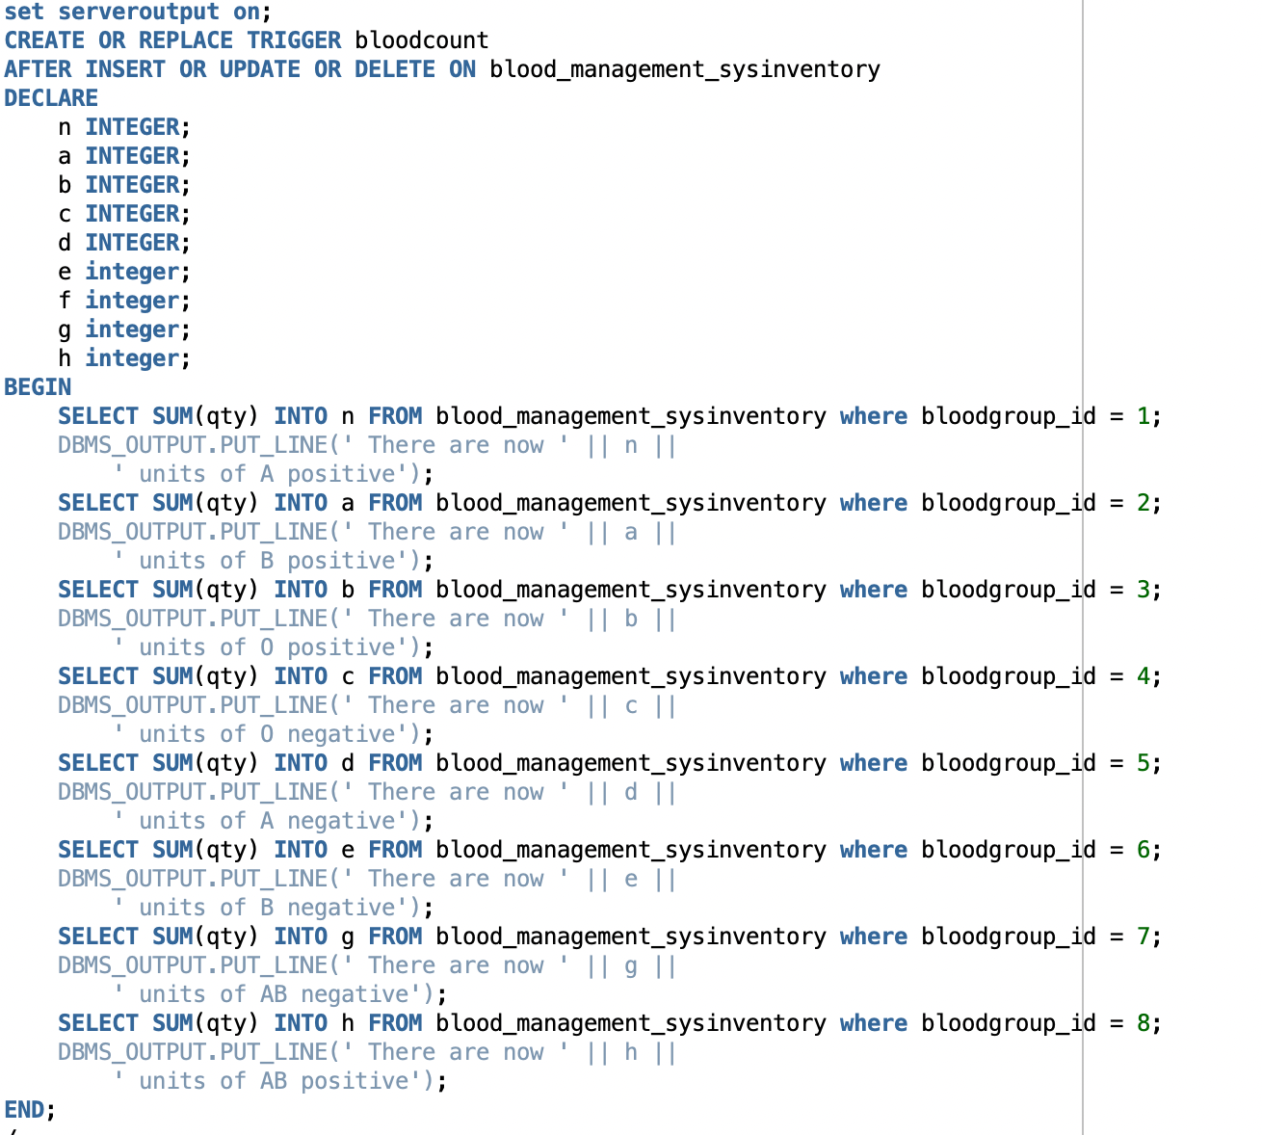
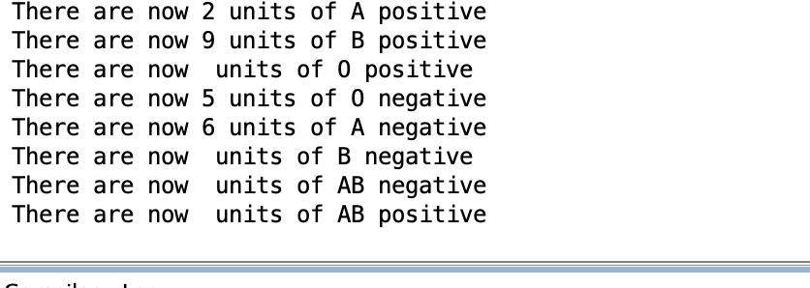
TRIGGERS

Slide 9
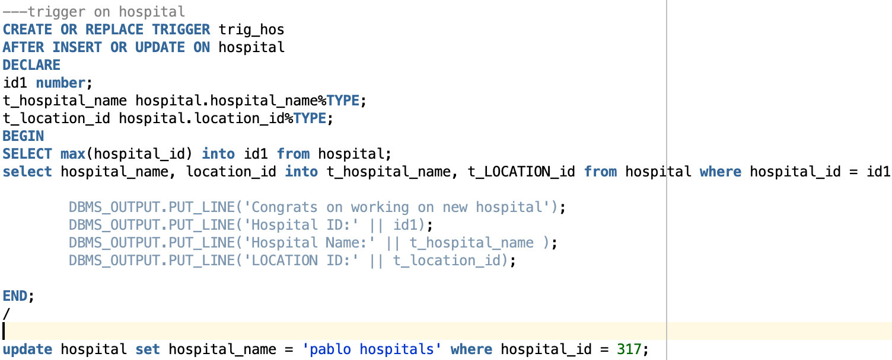
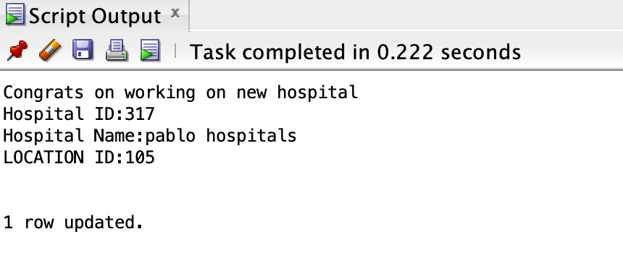
Triggers

Slide 10
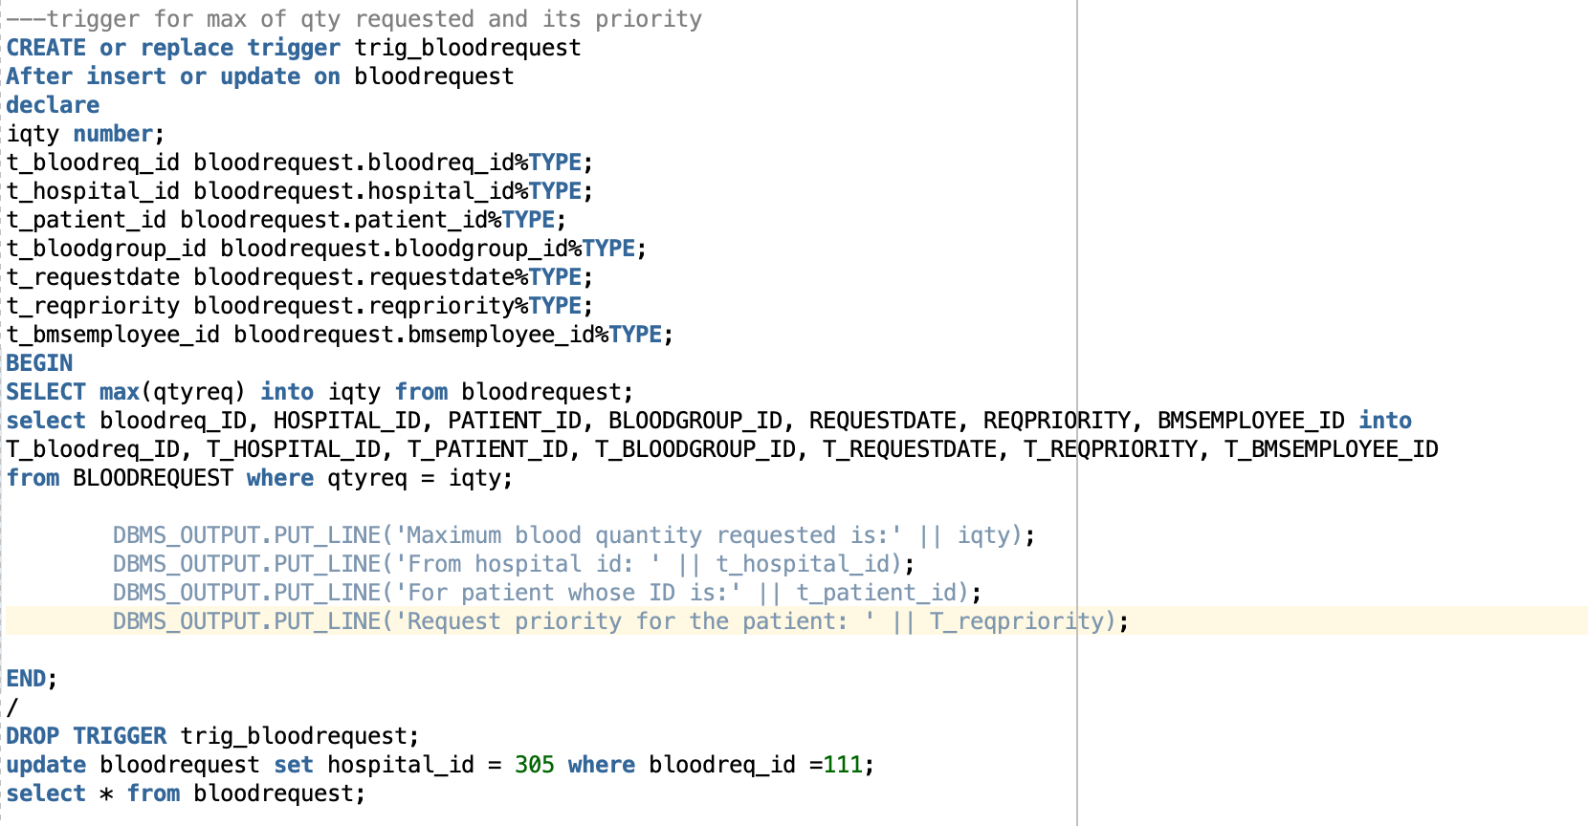
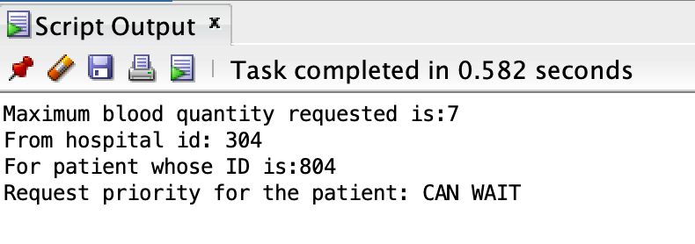
Triggers

Slide 11
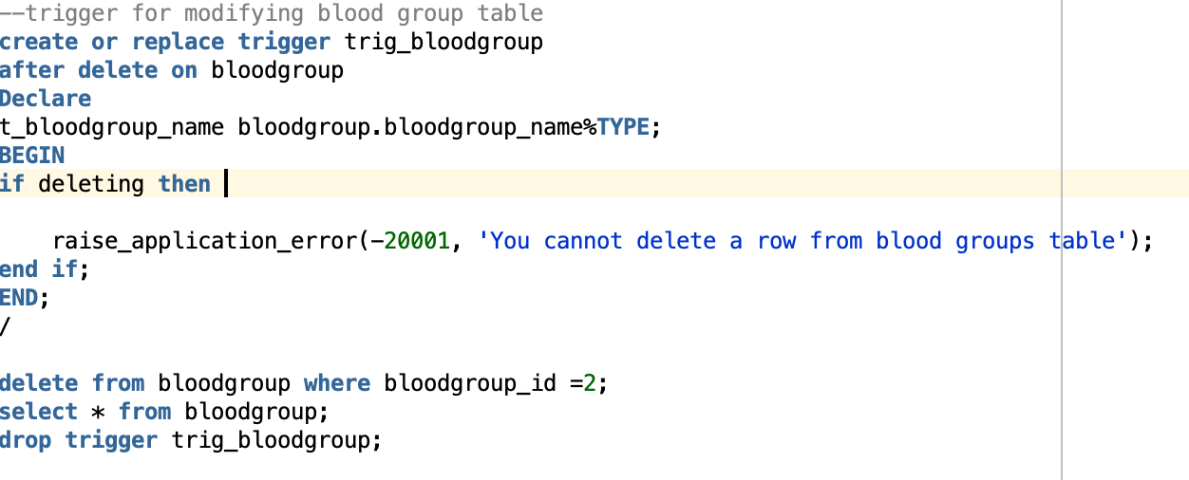
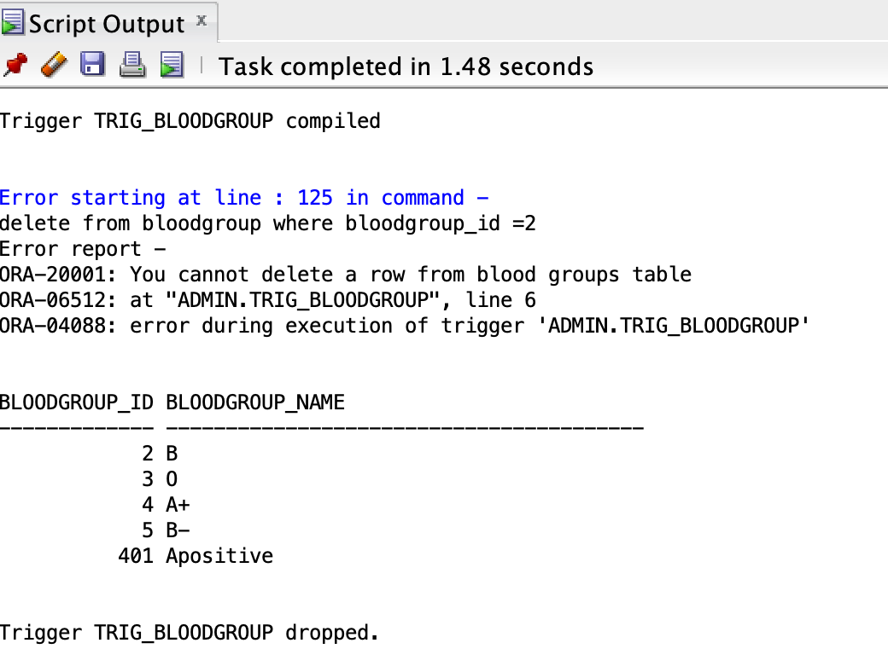
Triggers

Slide 12
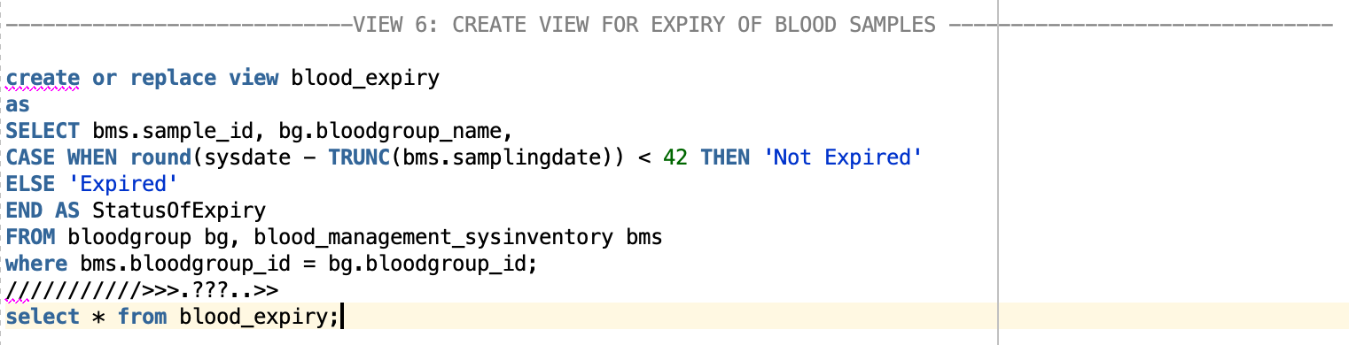
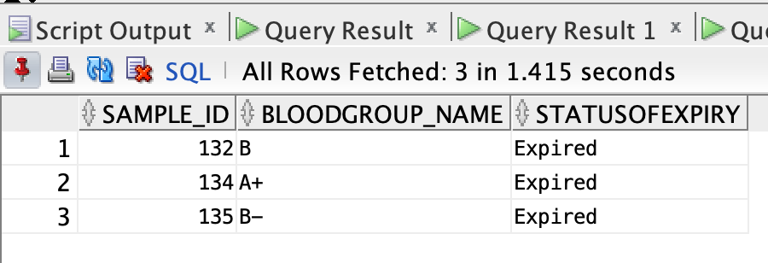
Views

Slide 13
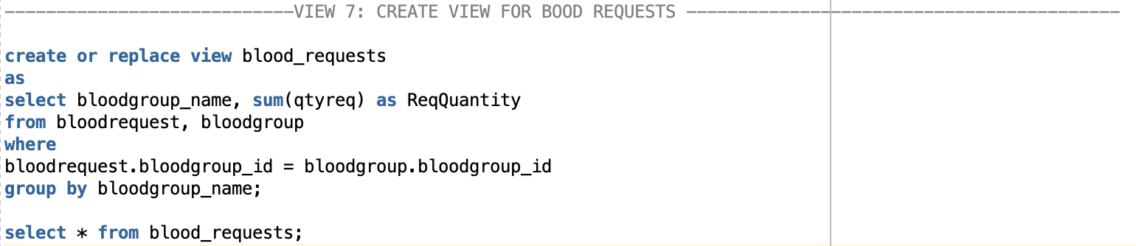
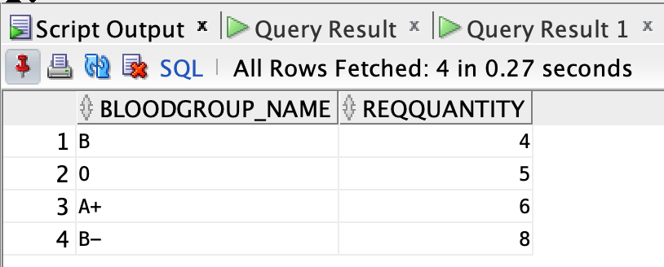
Views

Slide 14
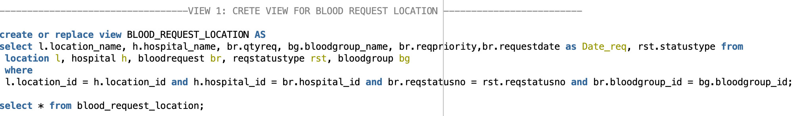
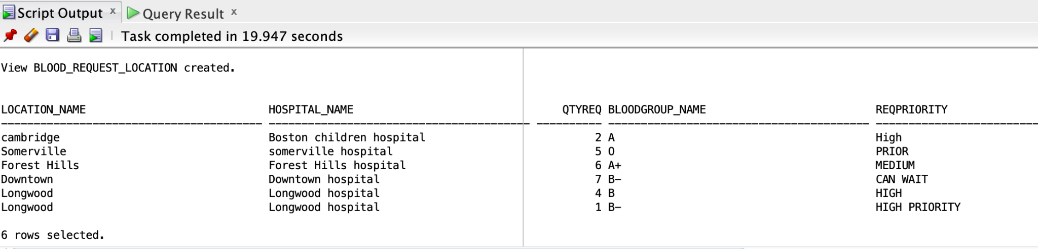
Views

Slide 15
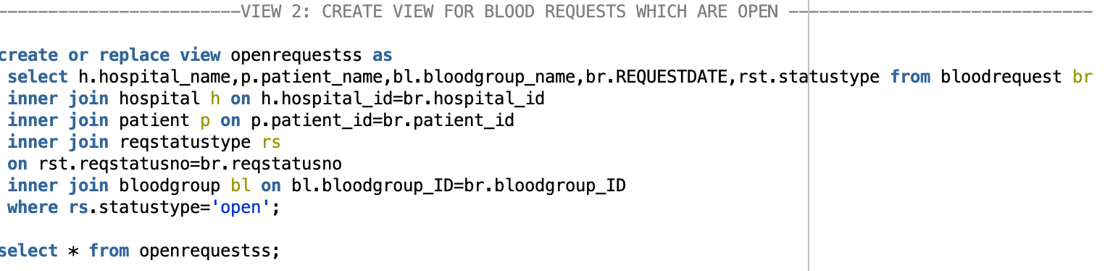
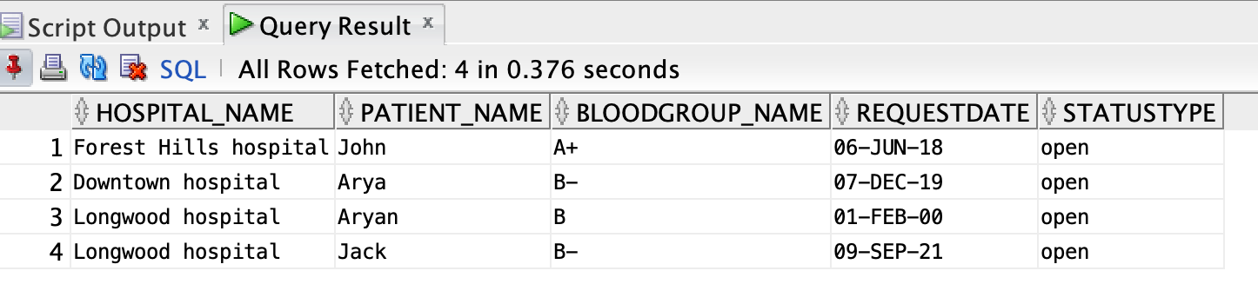
Views

Slide 16
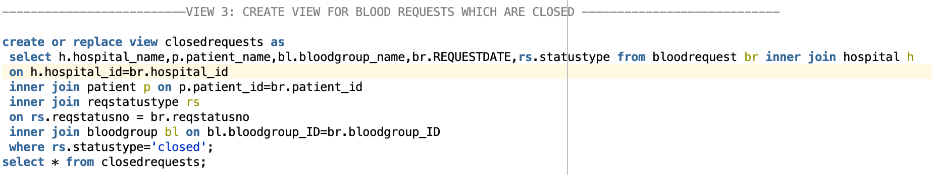
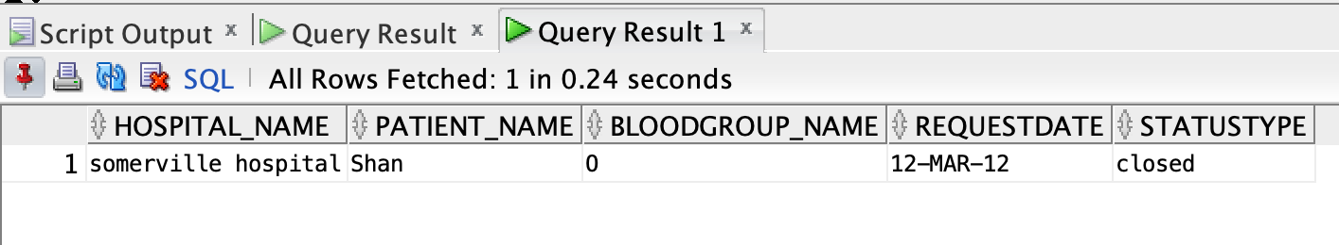
Views

Slide 17
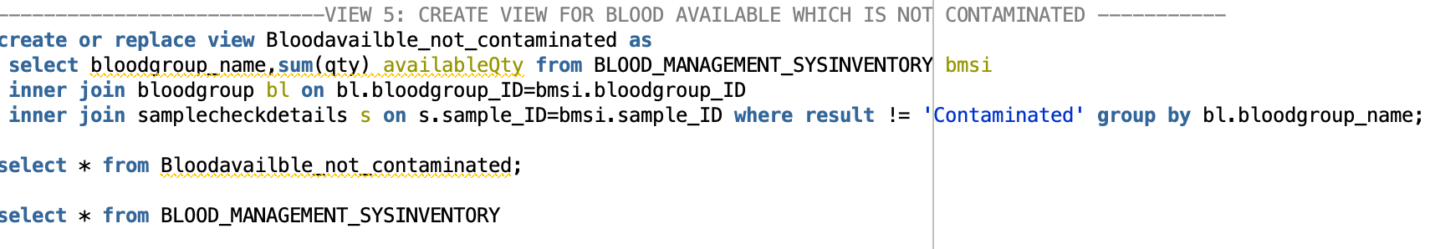
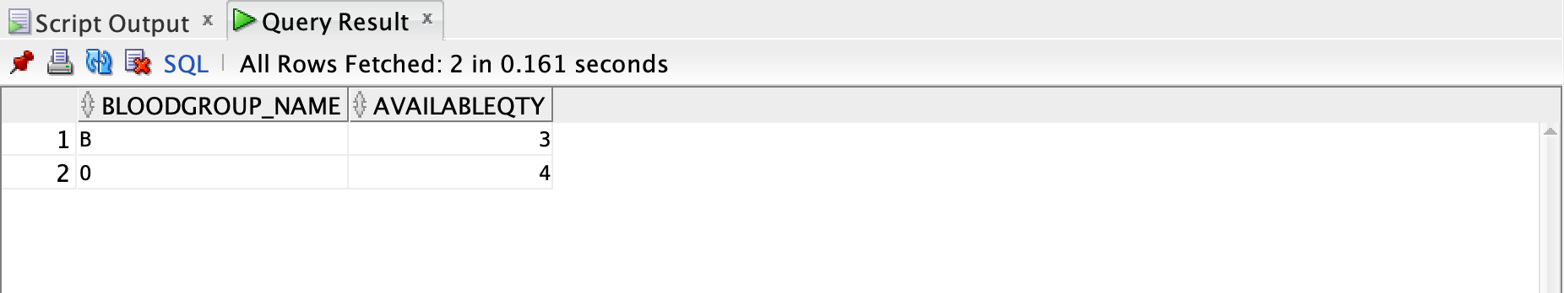
Views

Slide 18
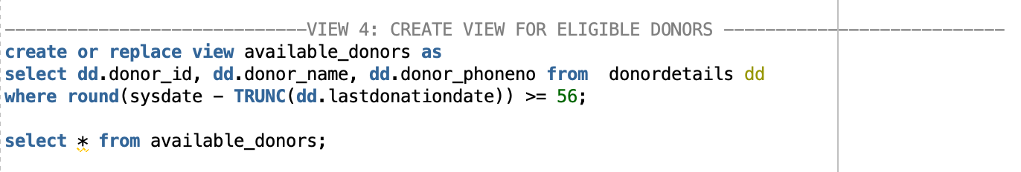
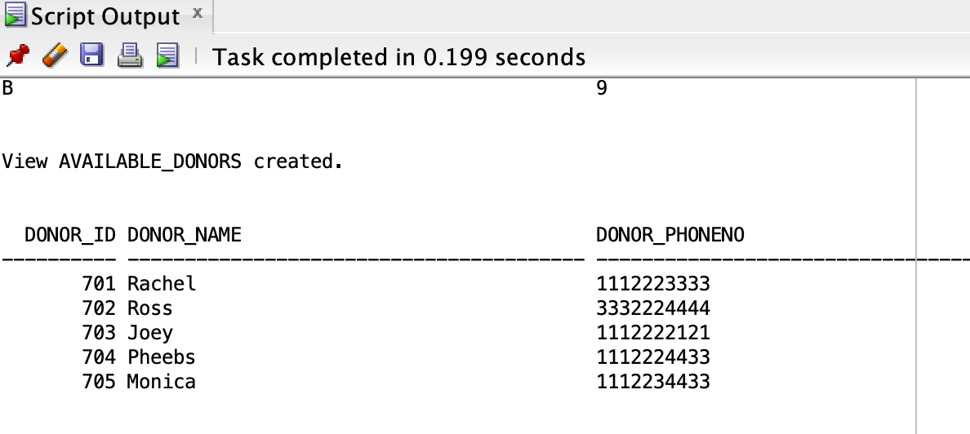
Views

Slide 19
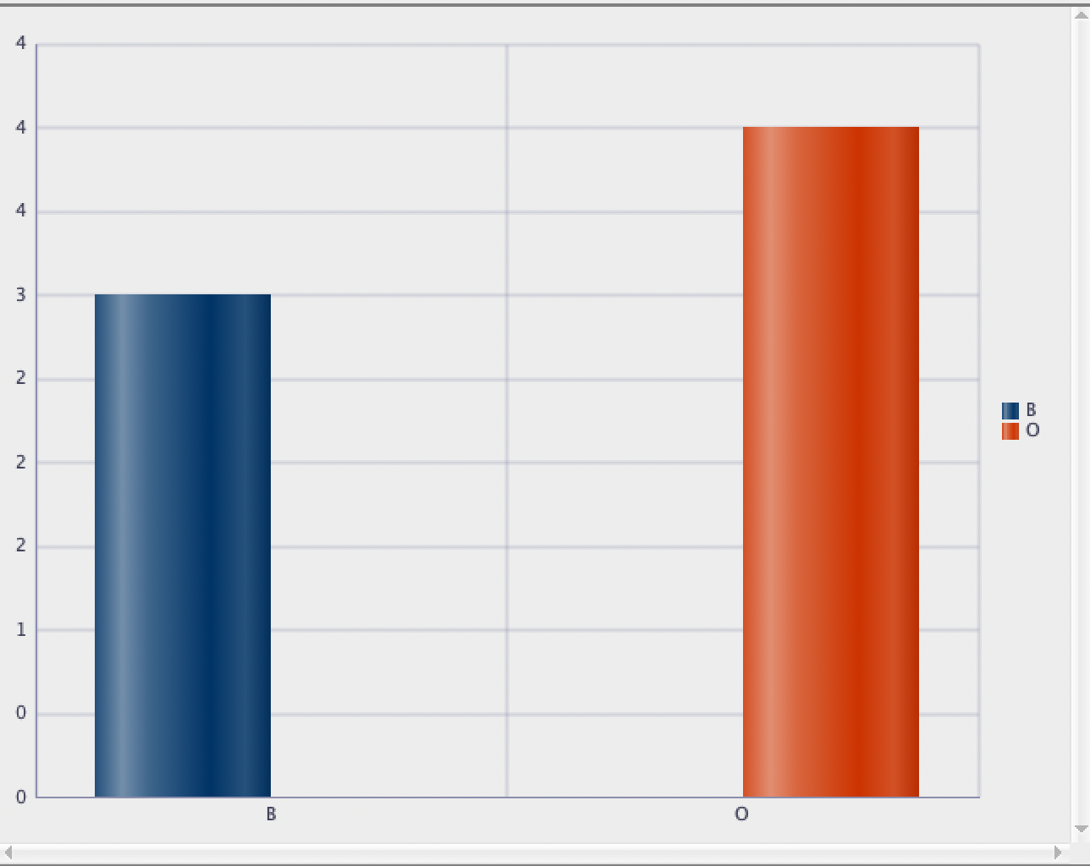
Reports
Blood available in the inventory that is not contaminated
Here blood groups B and O are available in the shown quantities are available that are not contaminated.

Slide 20
Contributions
Vaishnavi Sai Challagulla: Stored Procedures, Functions
Srihitha Kilari: Triggers, Views
Kavya Mannem: Table creation, Data Insertion and Creation of Indexes

Slide 21
THANK YOU

